Slide 1

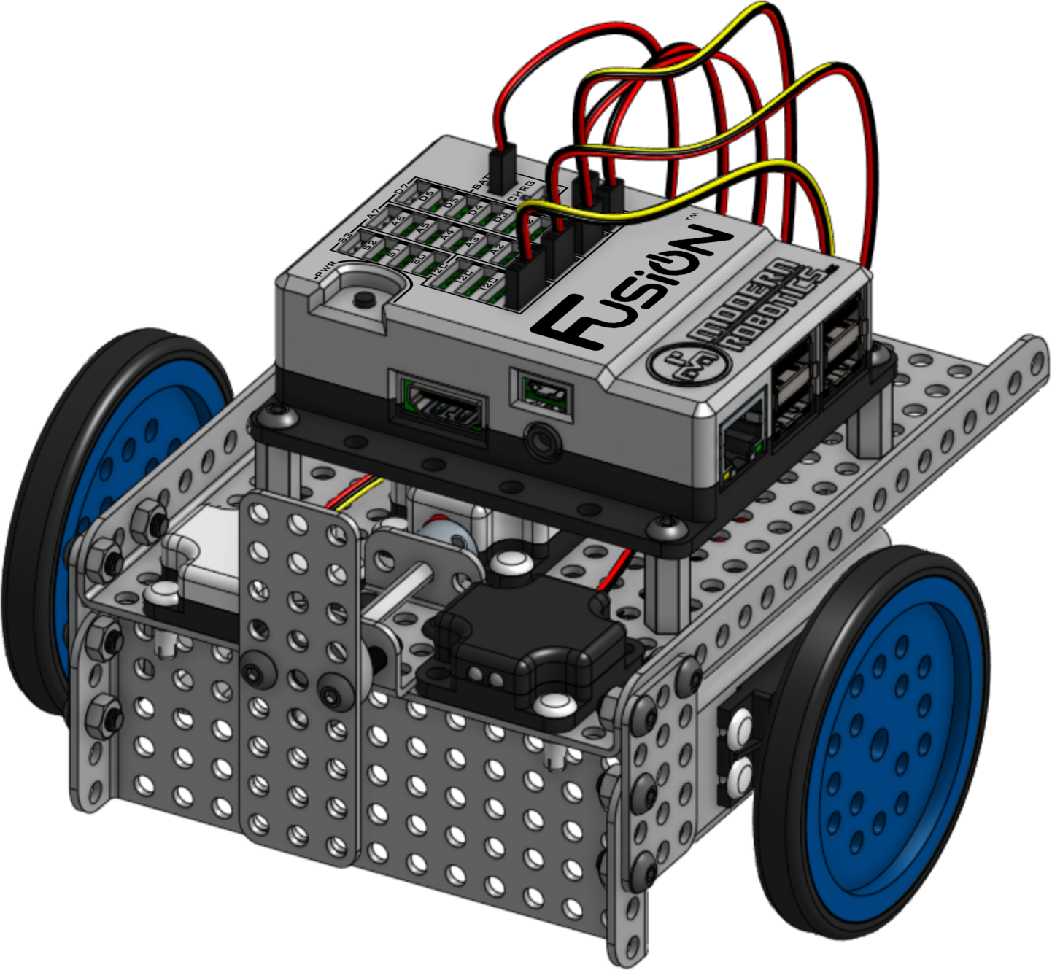
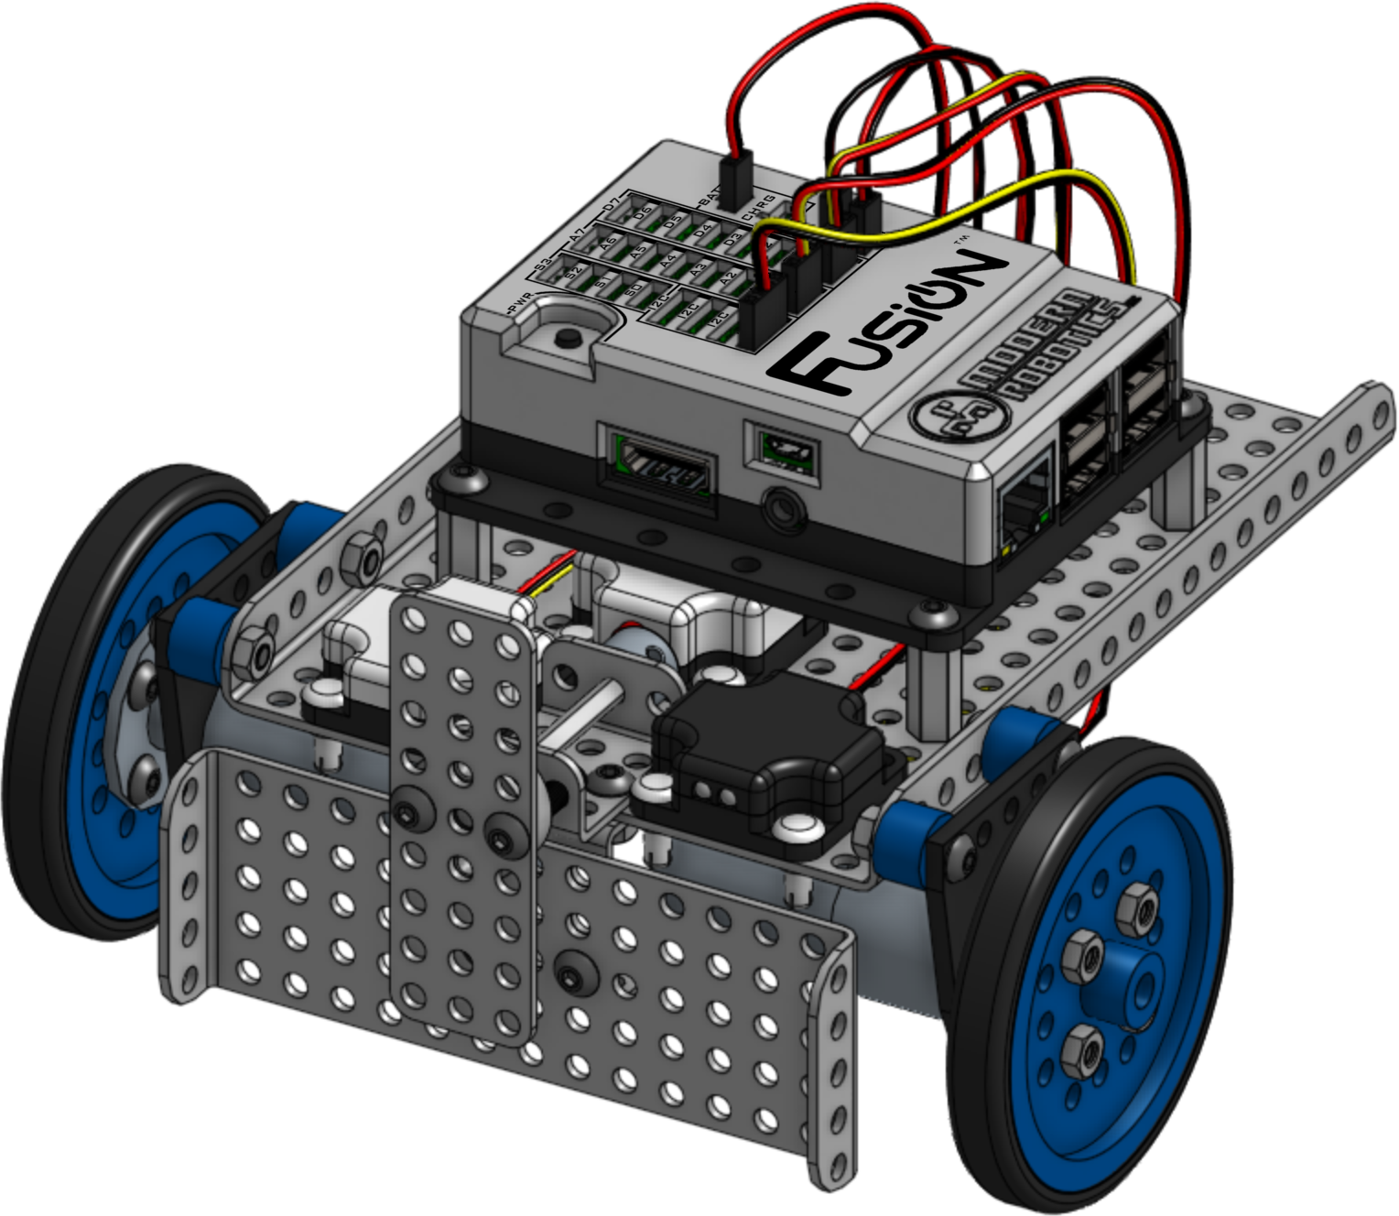

Base Bot
Modification Instructions
Version 1.0.0
Modern Robotics, Inc.

Slide 2
These instructions outline how to modify a Fusion Base Bot to use the higher torque DC motors.
Although the sensors used are different, this can be used to modify a Spartan Base Robot as well. You do not need to remove the Program Control Button (PCB) to make this modification.
The next page has a list of additional materials required for the modification. Take note that the Quick Connects are moved when the sensors are reattached to avoid hitting the motors underneath.
Original Build
This document is published by Modern Robotics, Inc. No part of this document may be copied, published in print or shared online or otherwise publicly released without the express written consent of Modern Robotics, Inc.
Specifications subject to change without notice.

Slide 3

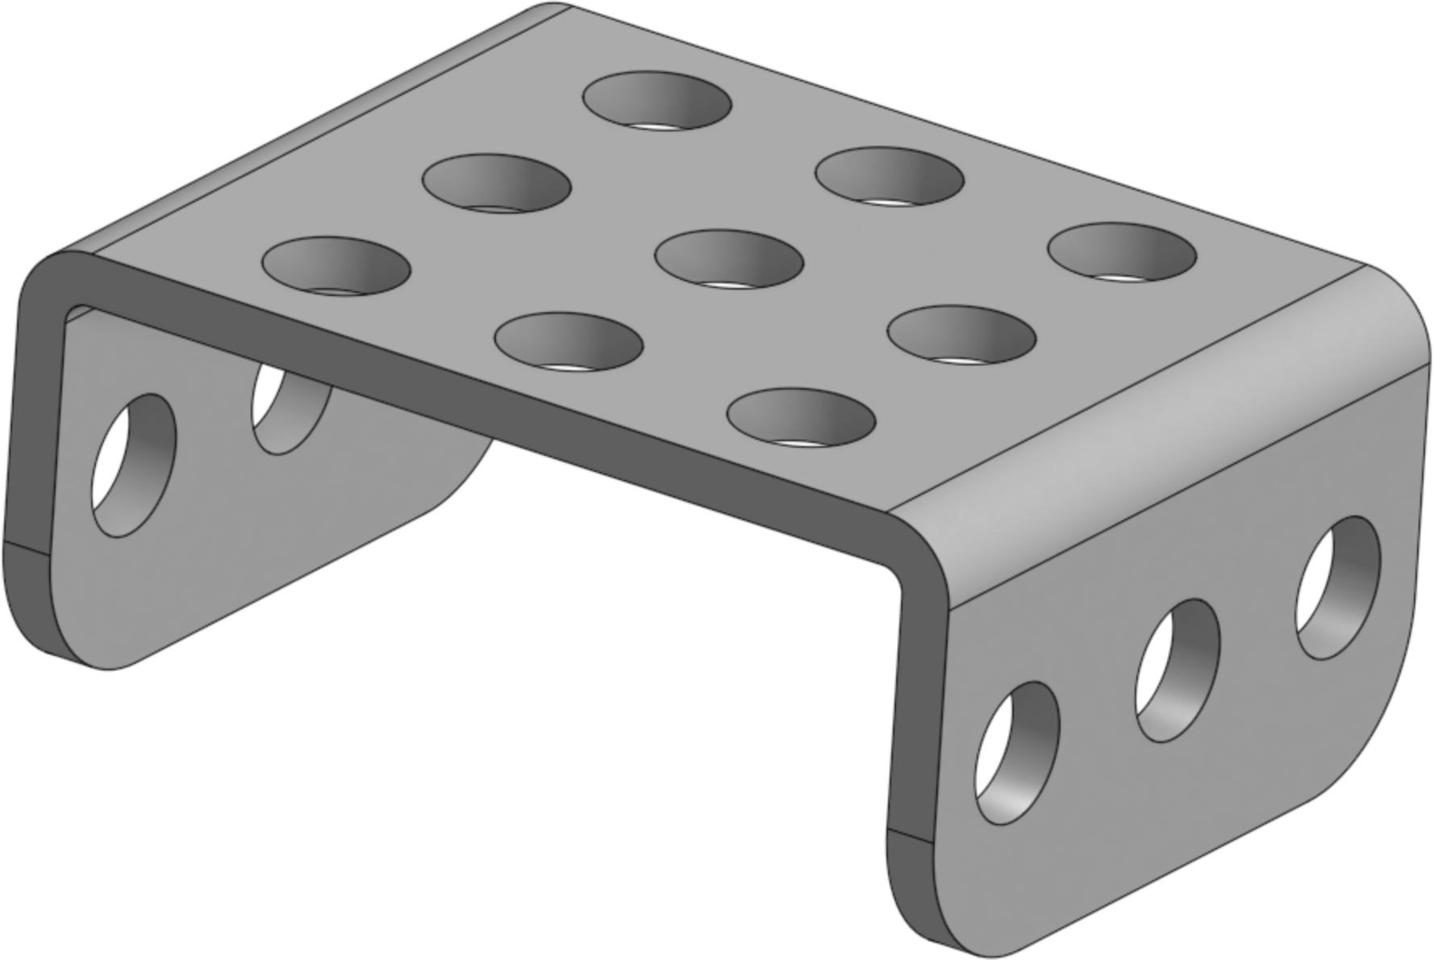

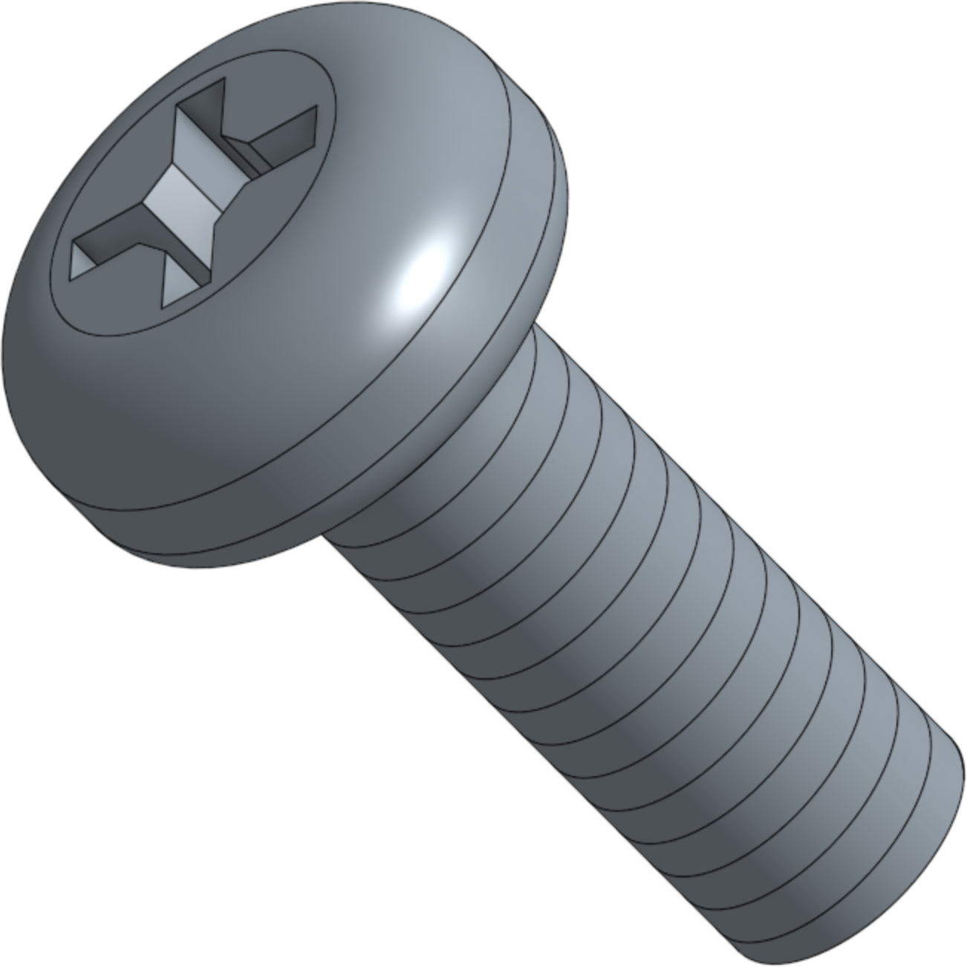
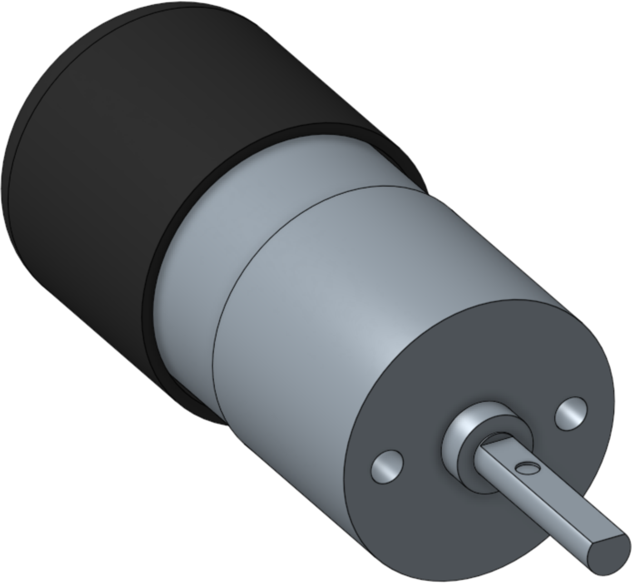
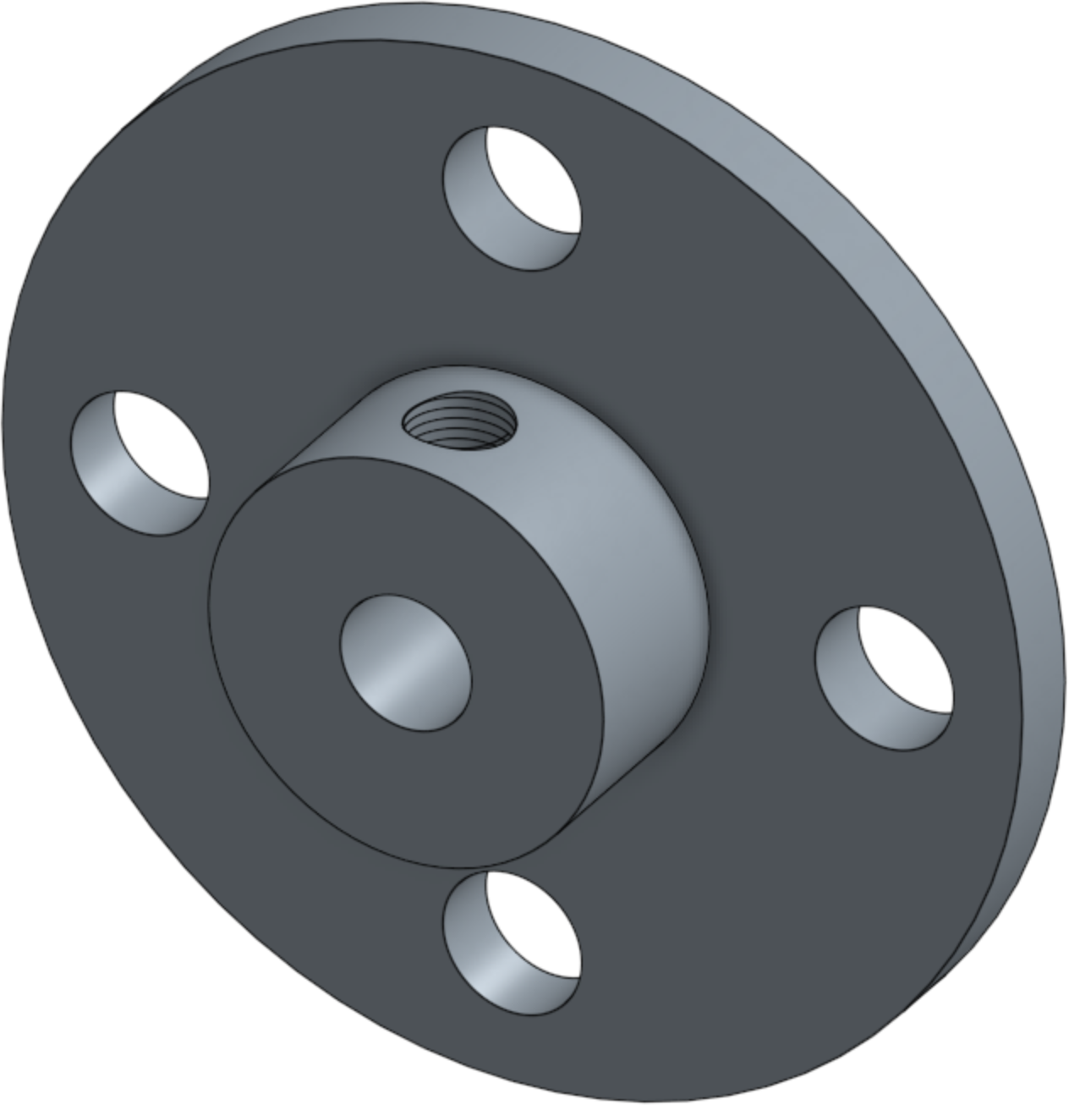
Parts Needed For Modification
x1 05-0303 3x3 Flanged Plate | x2 45-1065 Accessory Mount
x4 13-0004 8mm Spacer | x4 11-3100 M3 Motor Screw
x2 60-0026 4-Hole Wheel Hub | X2 14-0134 6V DC Motor

Slide 4
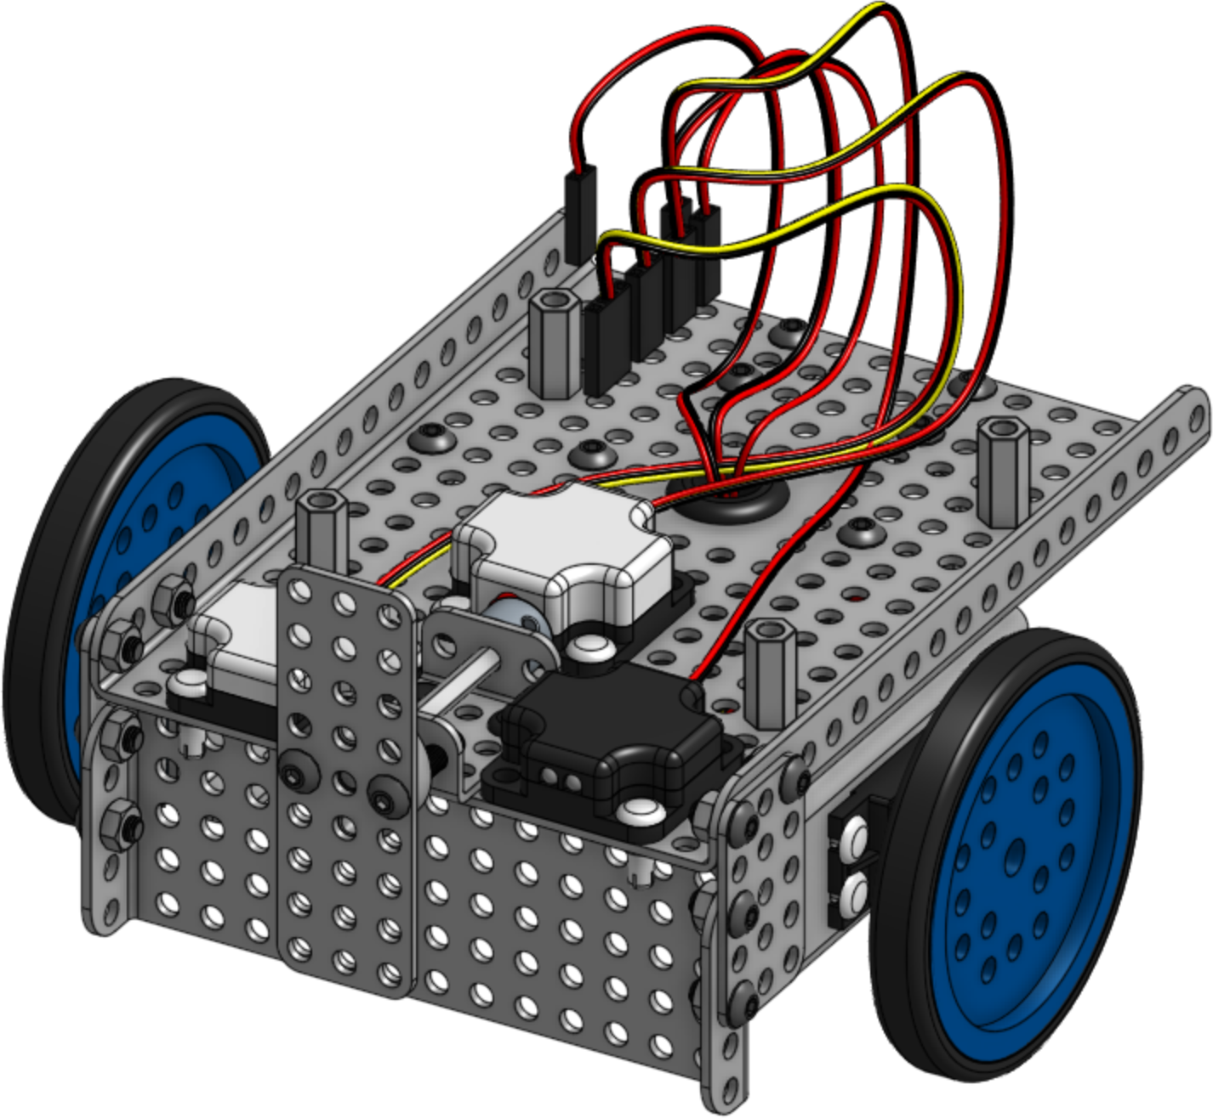
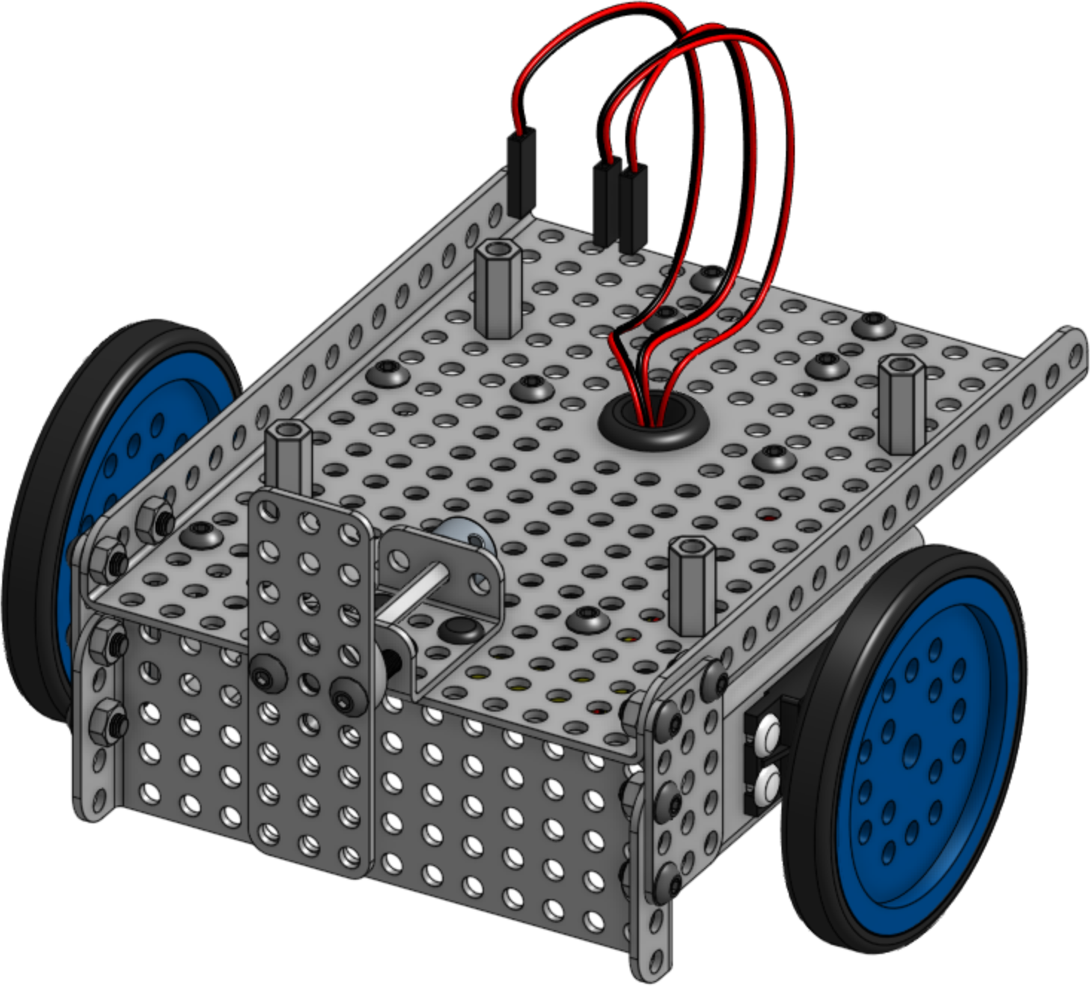
1
Remove the controller from the robot.
2
Remove the sensors from the robot.

Slide 5
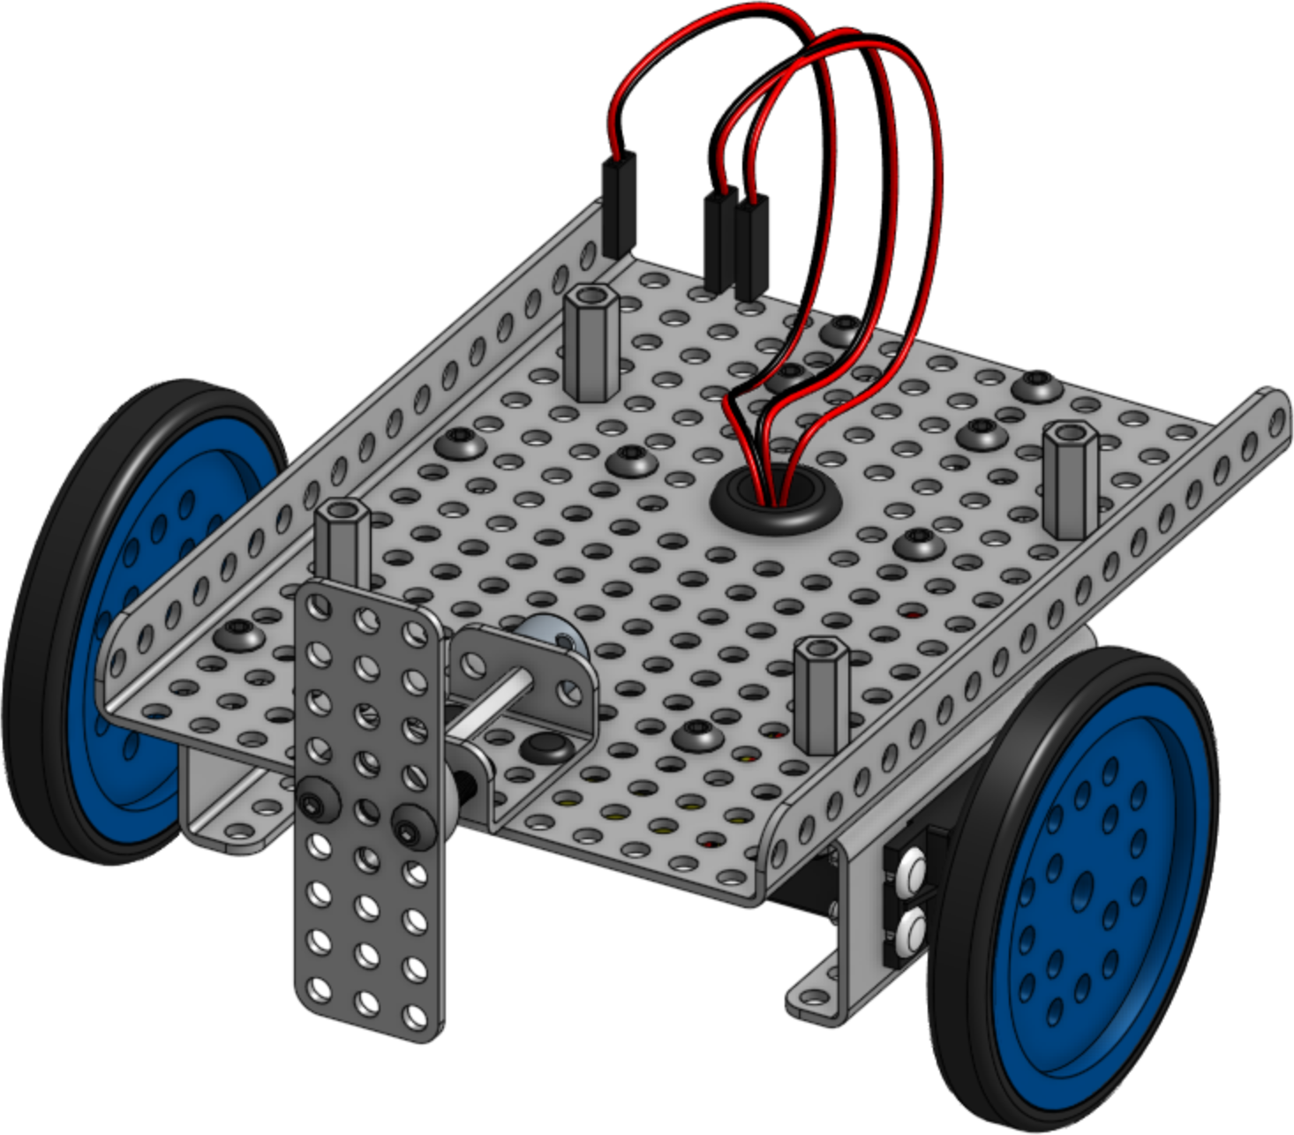
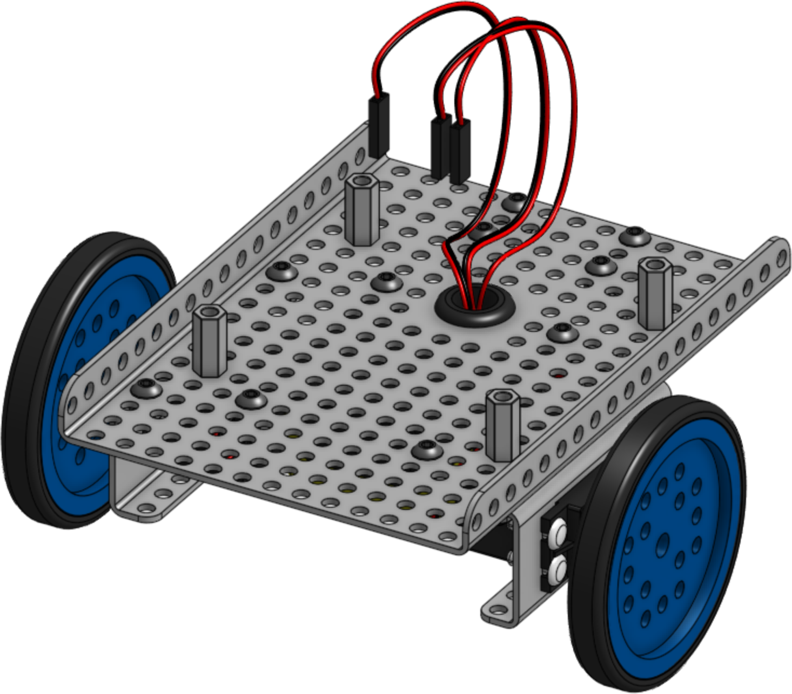
3
Remove the front plate from the robot.
Disassemble the front plate after removing.
4
Remove the Touch Sensor Plate Assembly
from the robot.

Slide 6
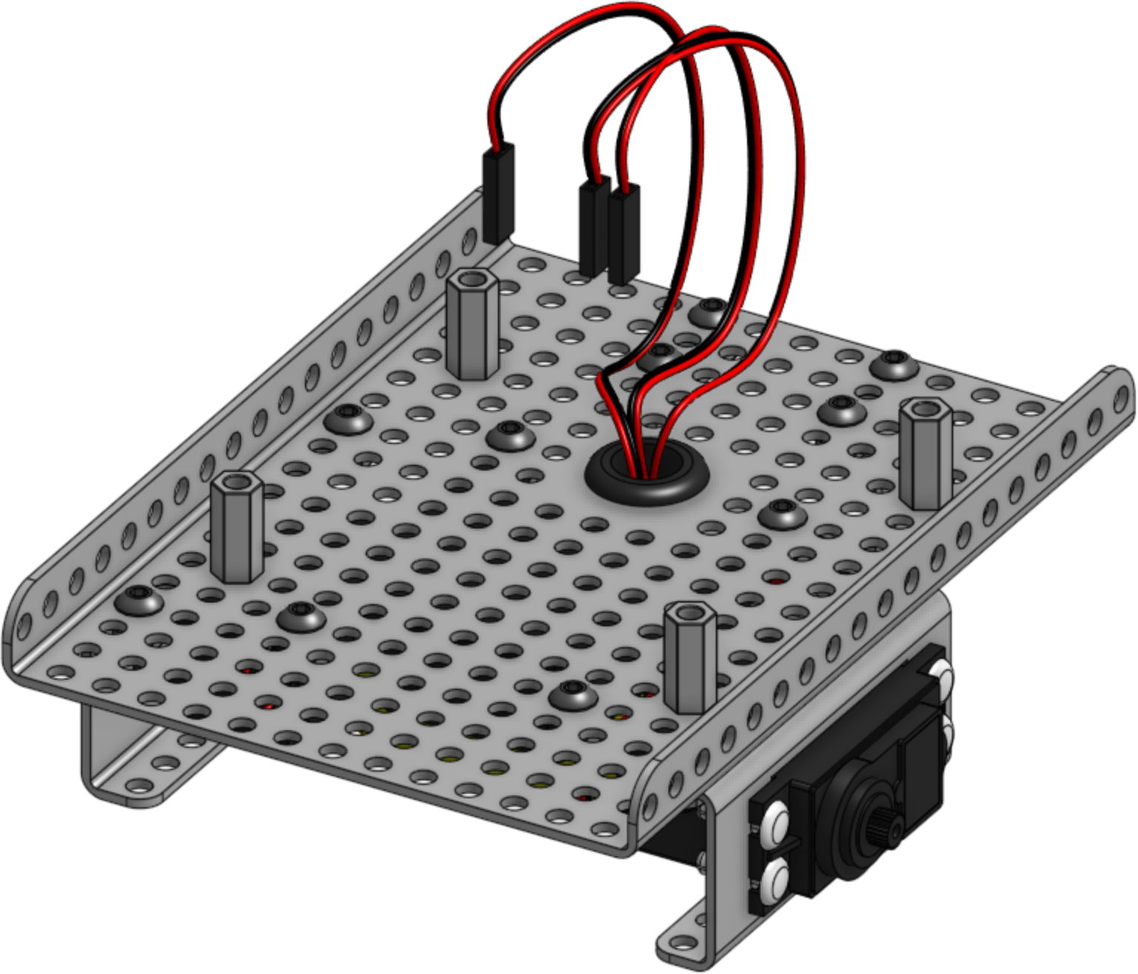
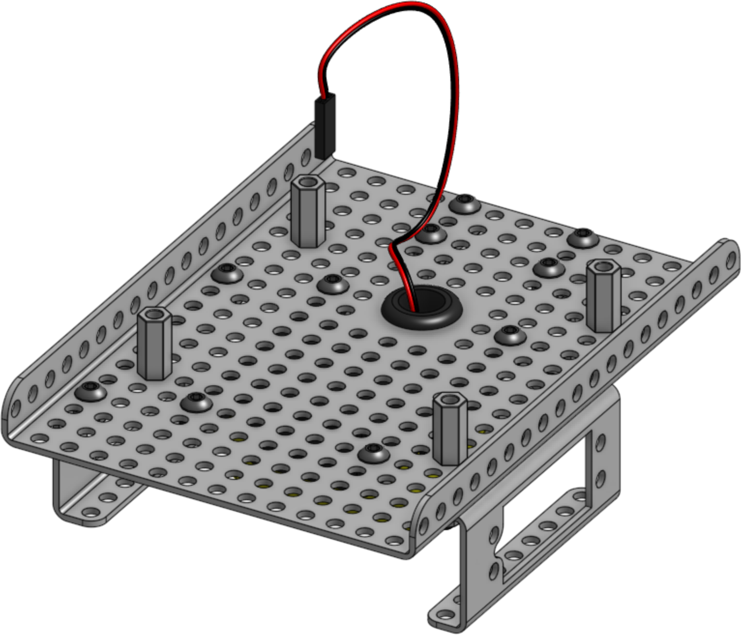
5
Remove the wheels from the servo style DC
motors.
6
Remove the servo style DC motors from the
motor brackets.

Slide 7
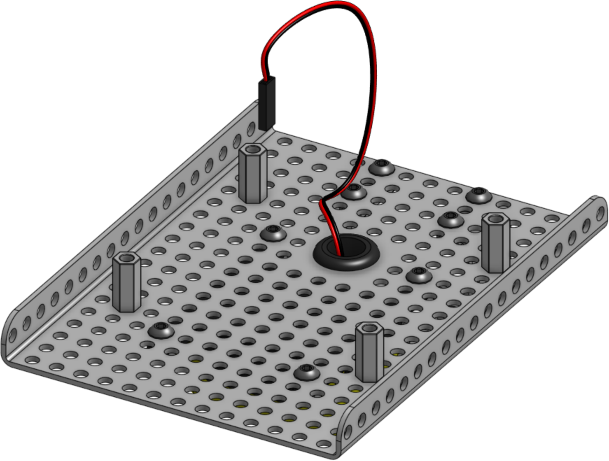
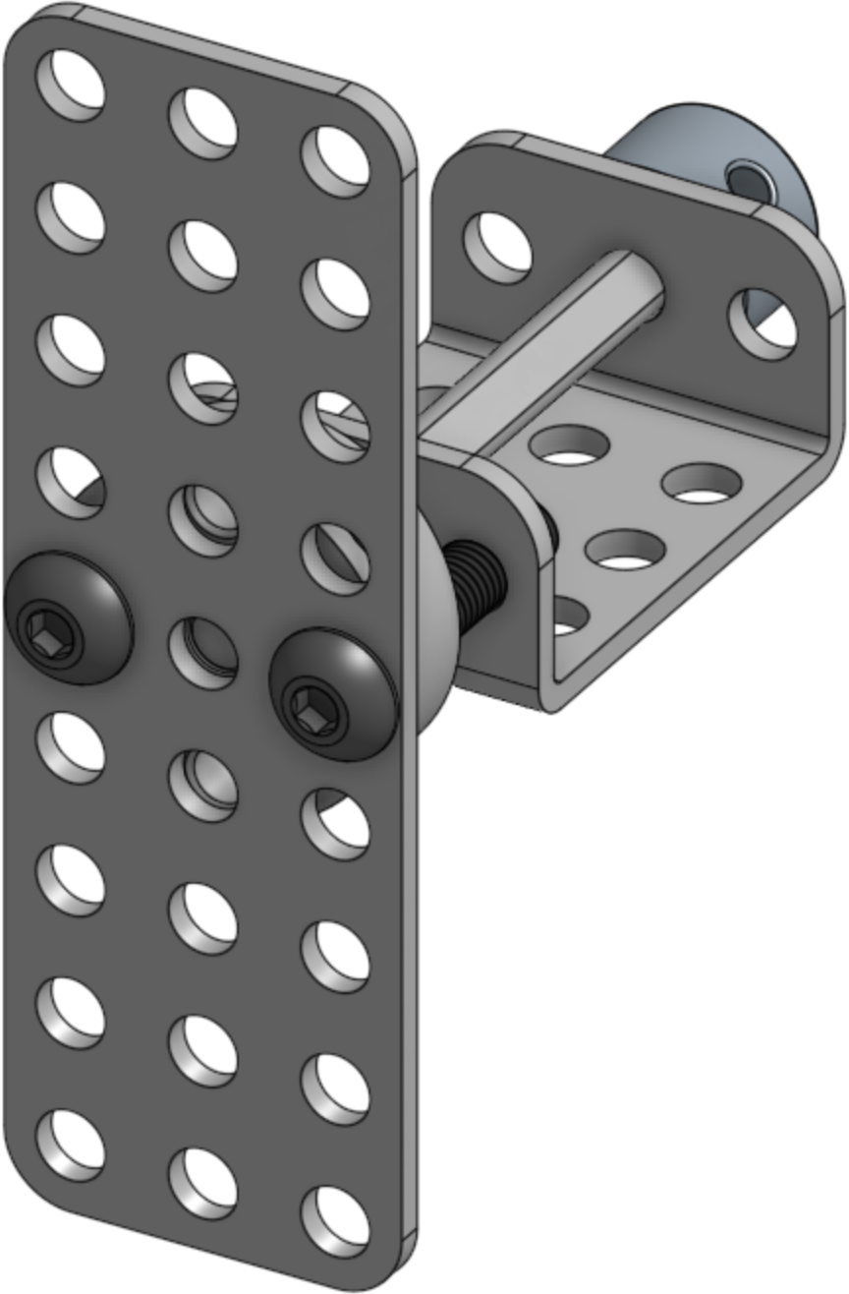
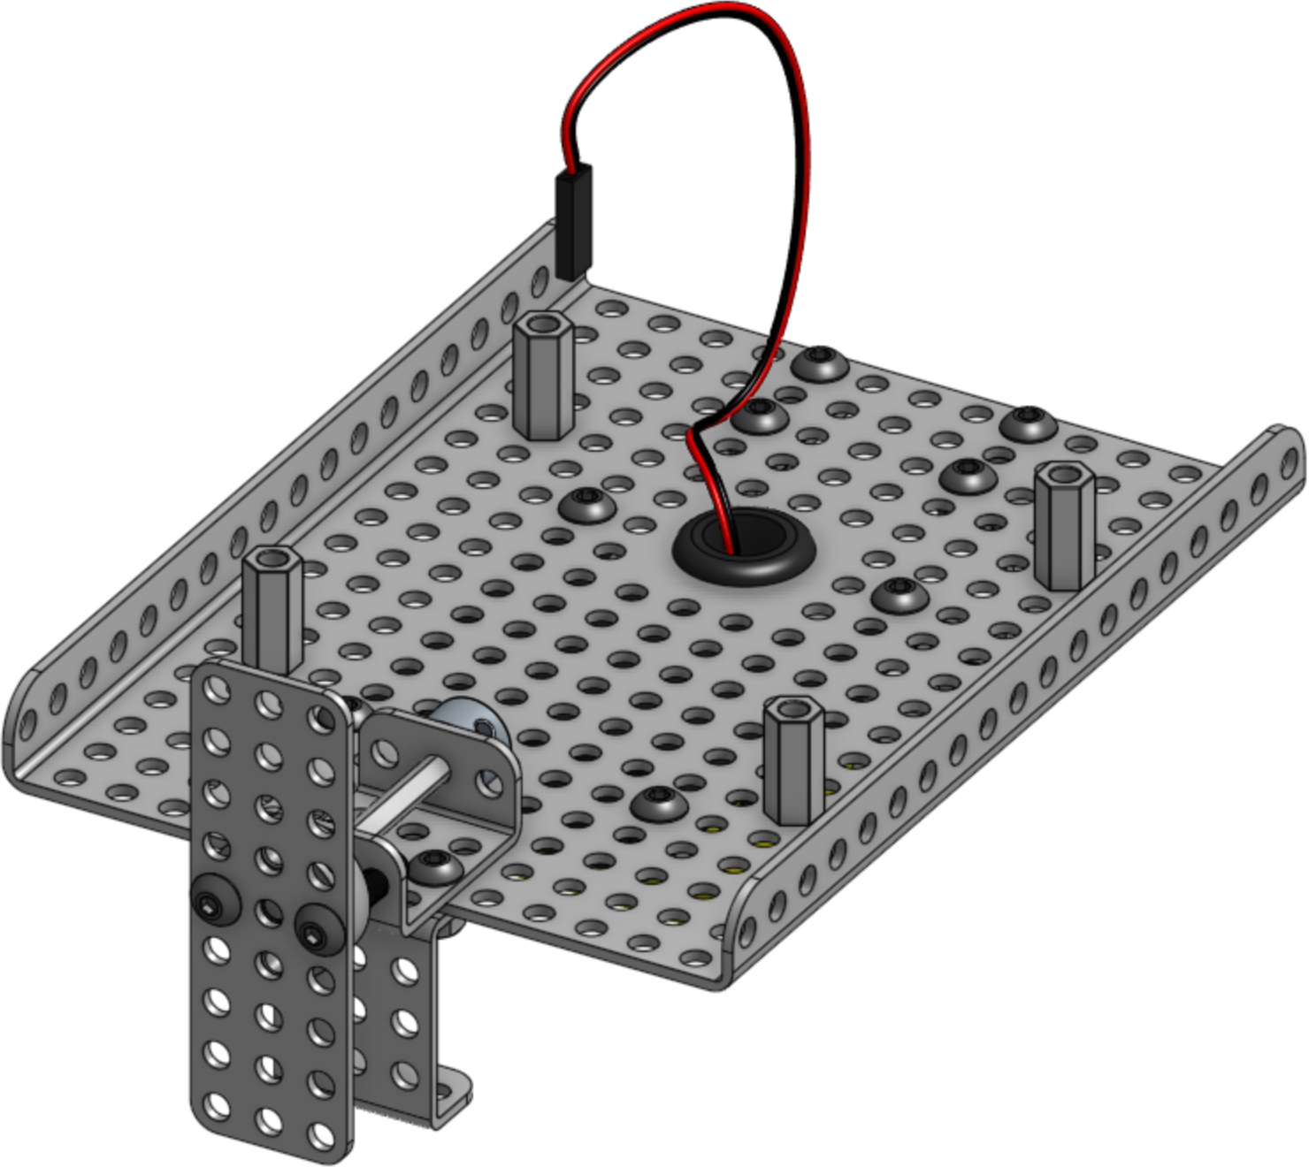
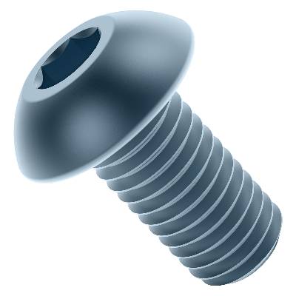
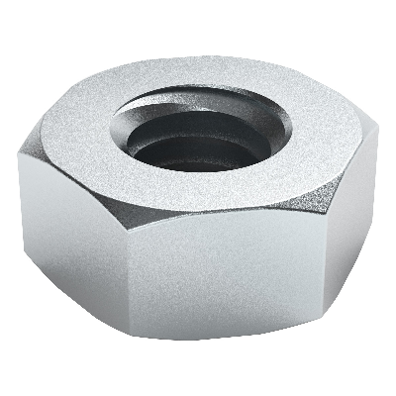
7
Remove the motor brackets from the base.
Assembly
8
Reattach the TS Plate
Assembly adding the 3x3
flanged
plate.
x1
x1
x2(8mm)
x2

Slide 8
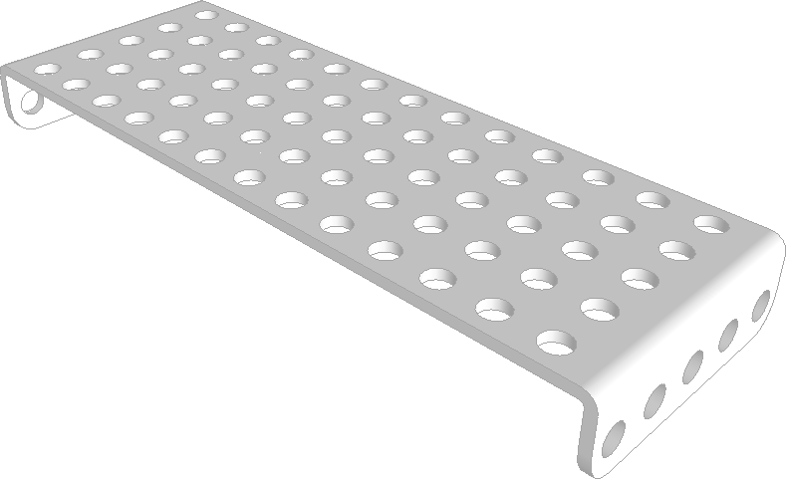
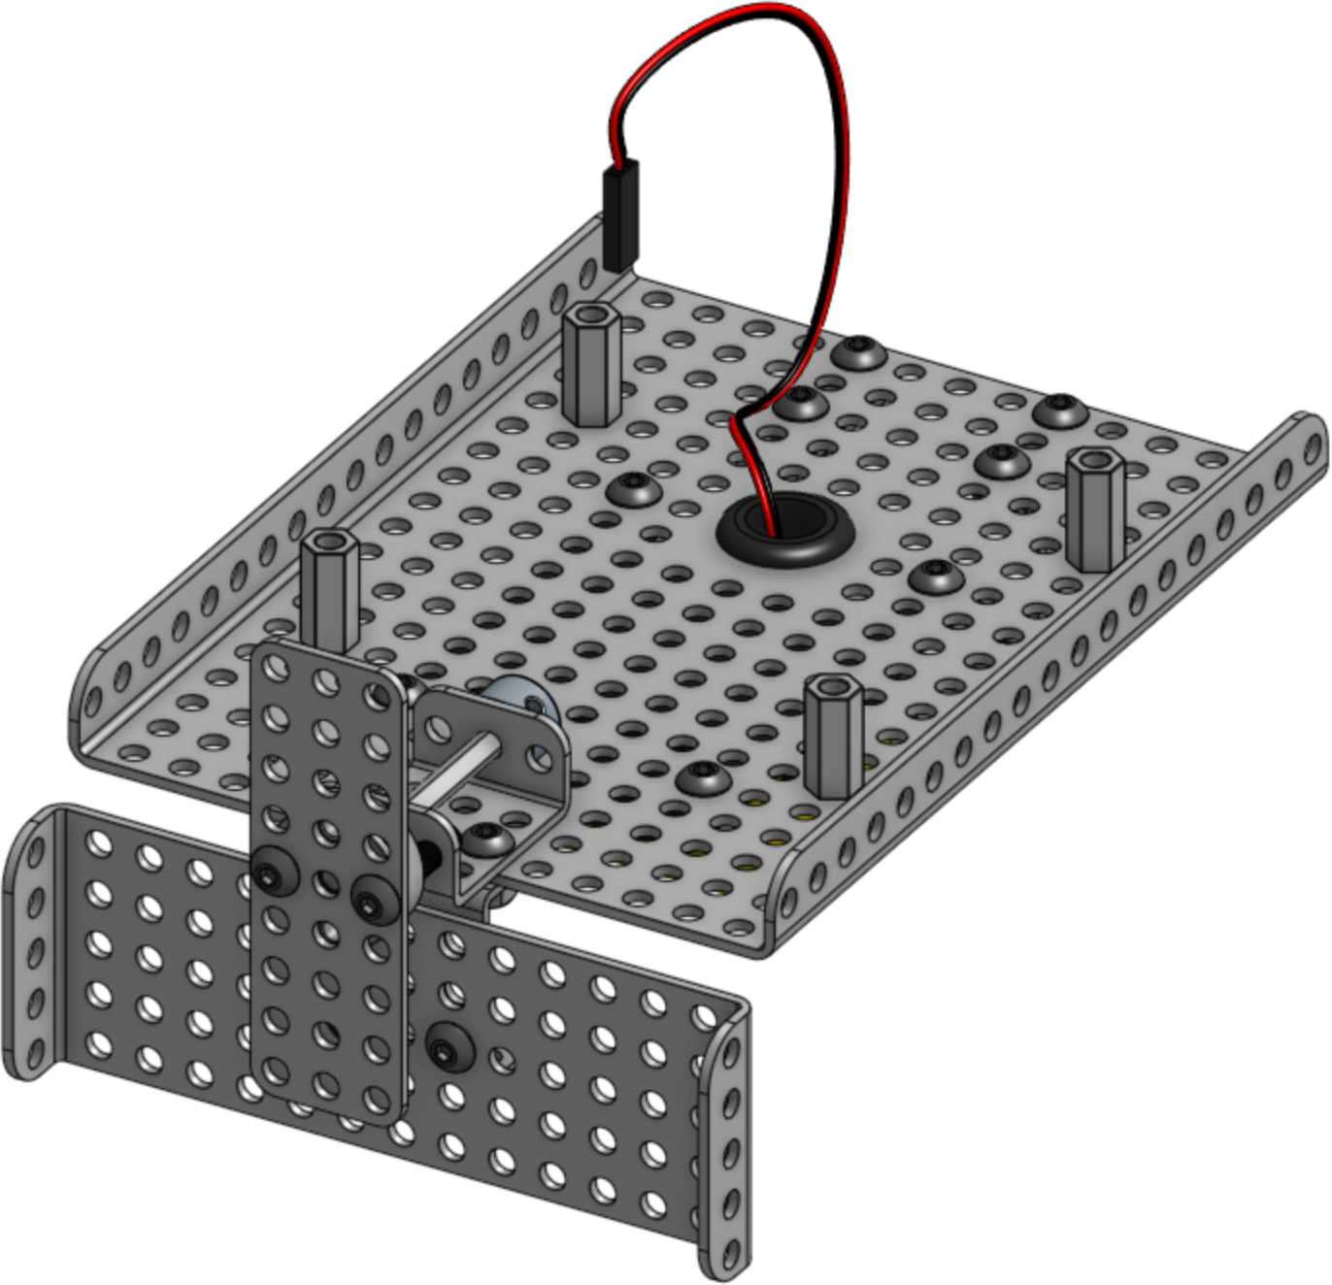
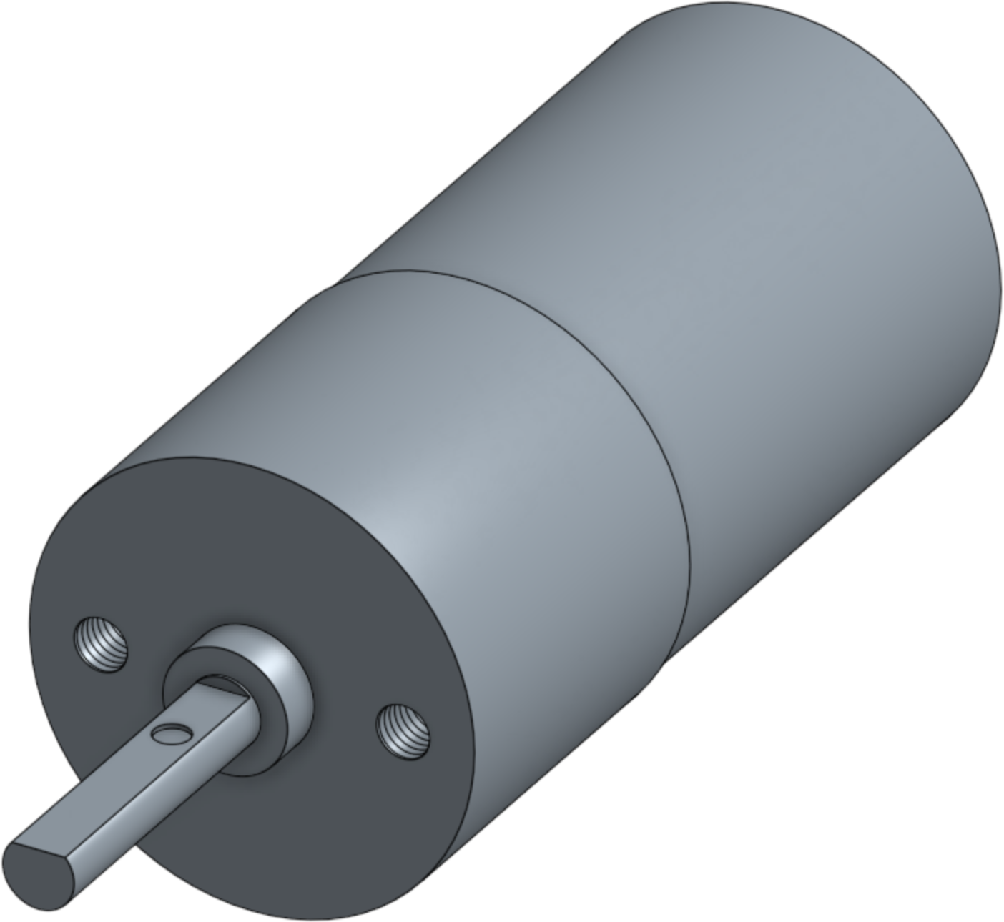
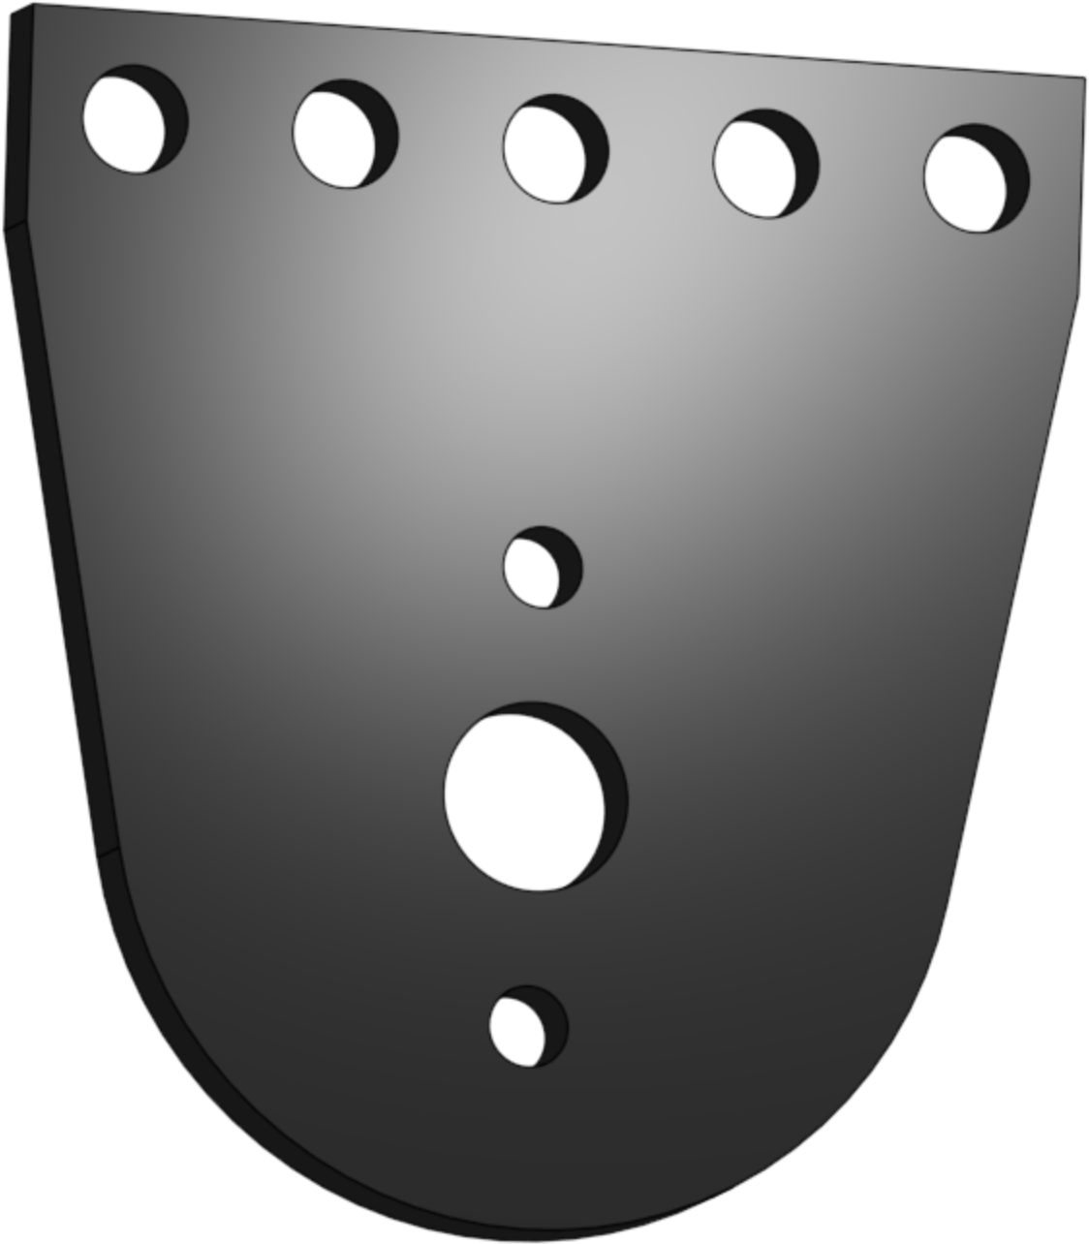
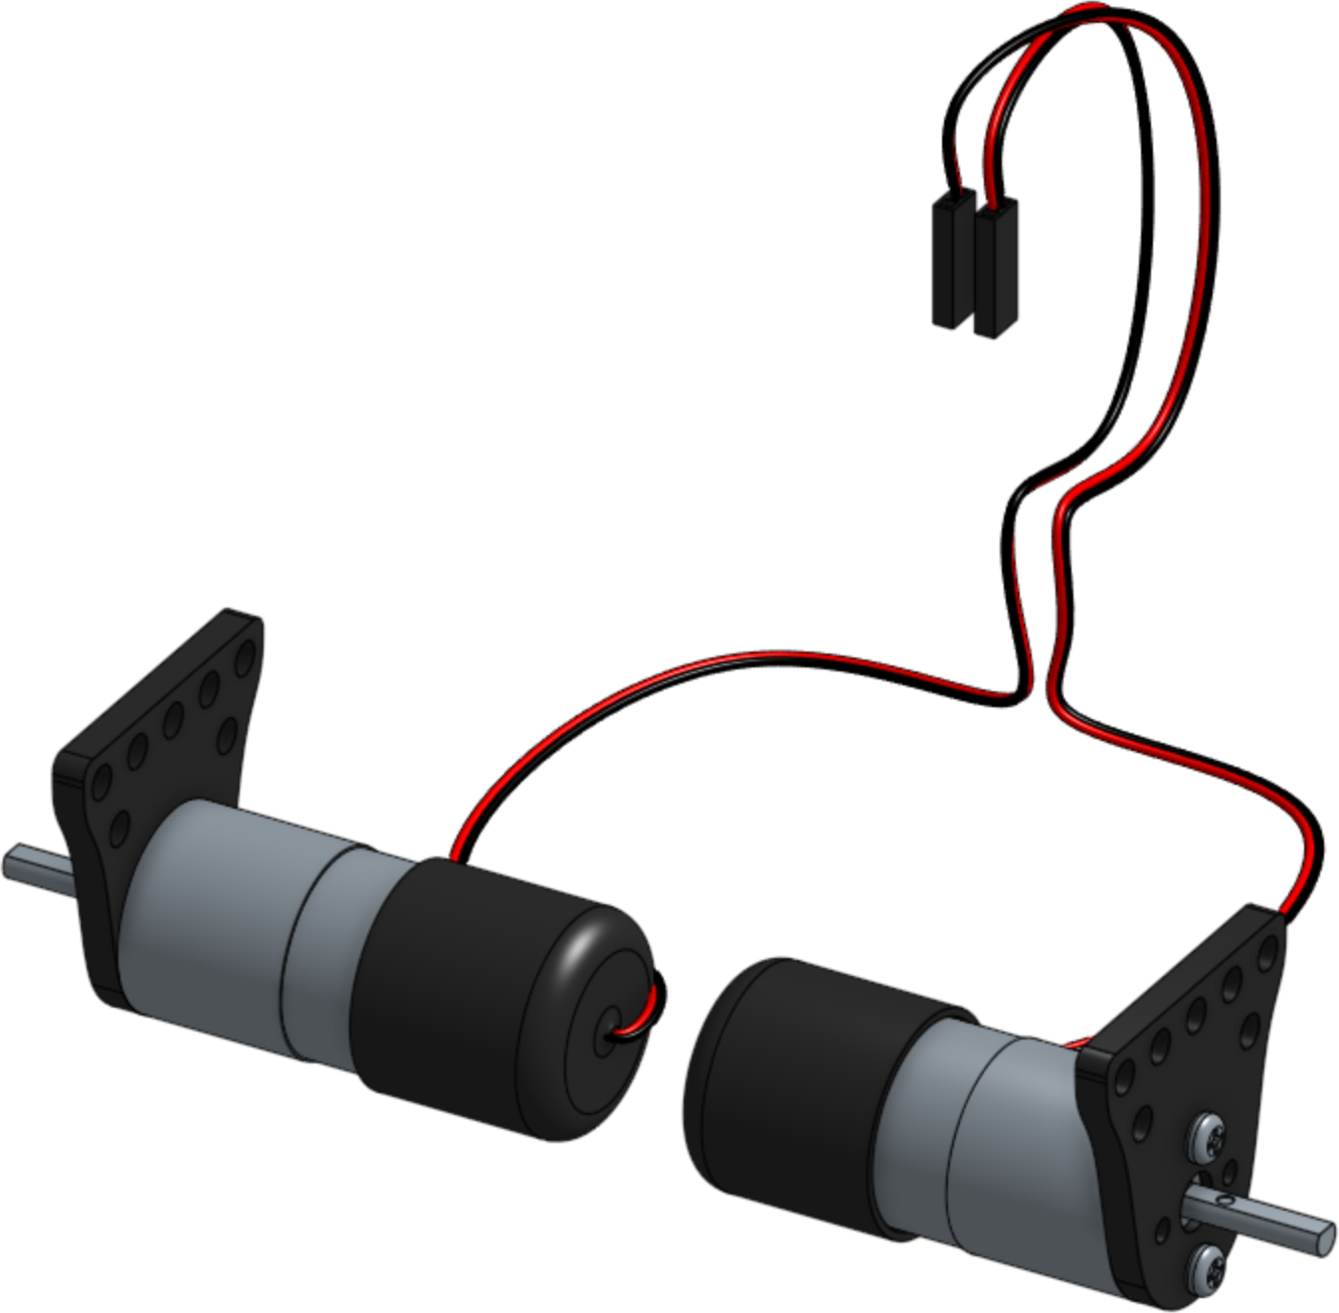
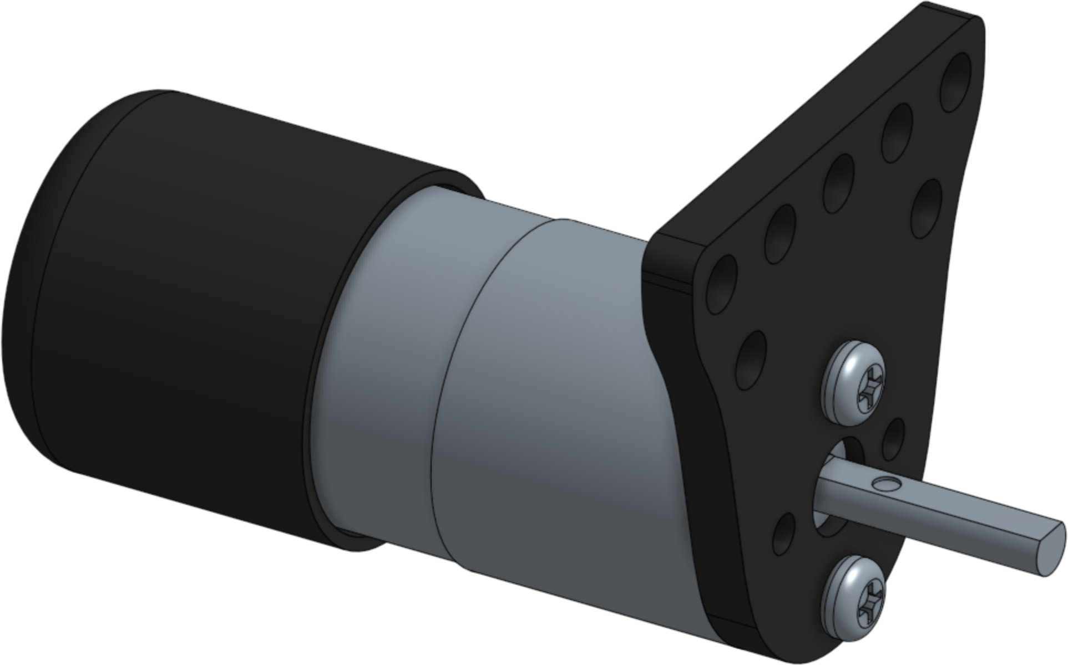
9
Attach the 5x13 plate to the
front of the bot.
x1
x2(8mm)
x2
10
Attach the motors to
the motor brackets
using the supplied
screws.
x2
x2
x4

Slide 9
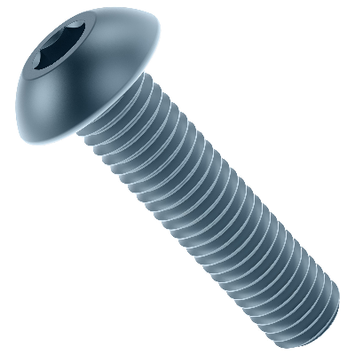
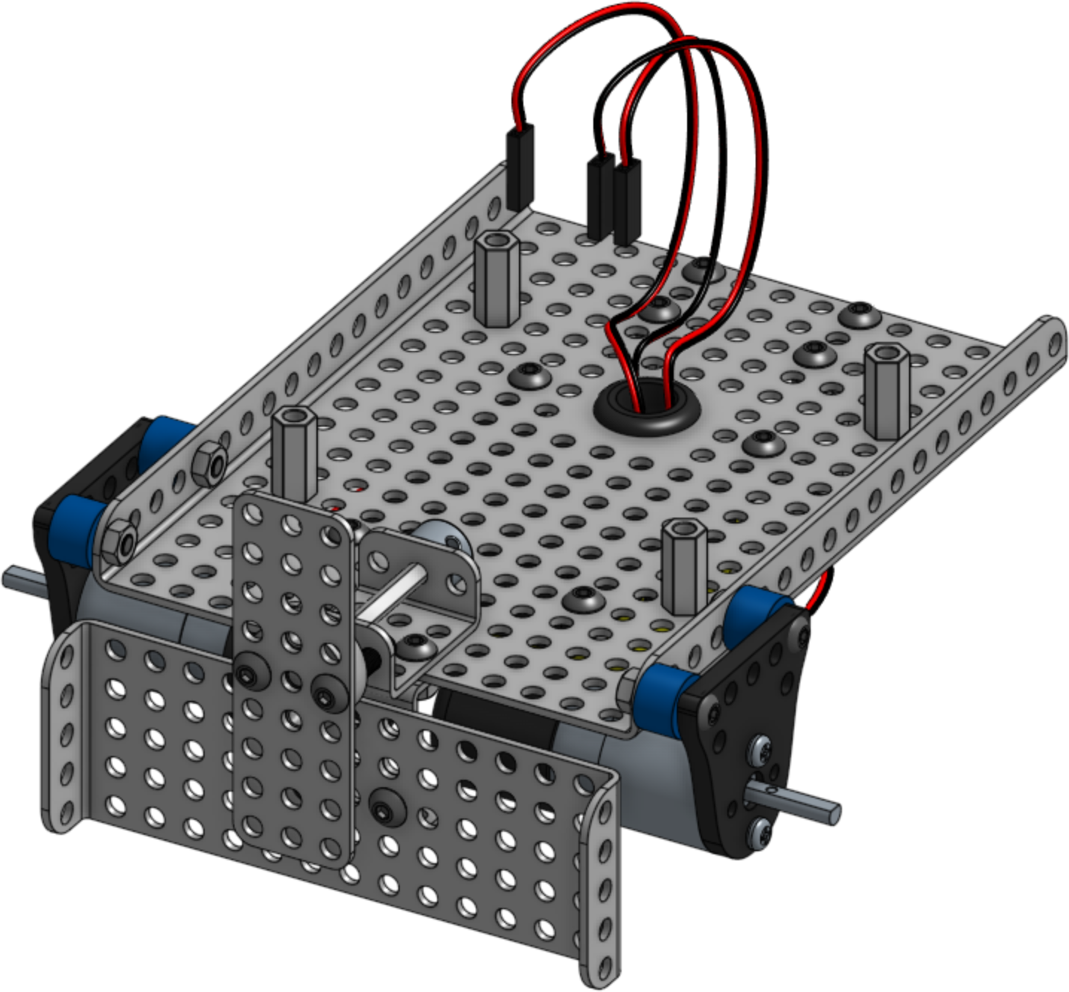
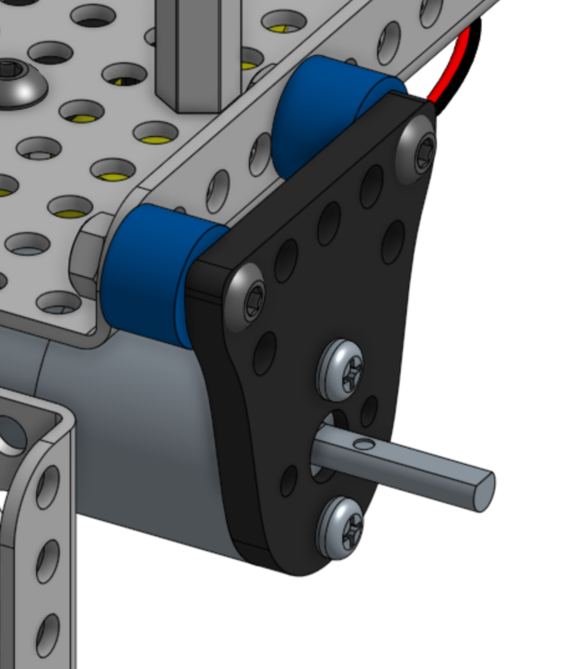

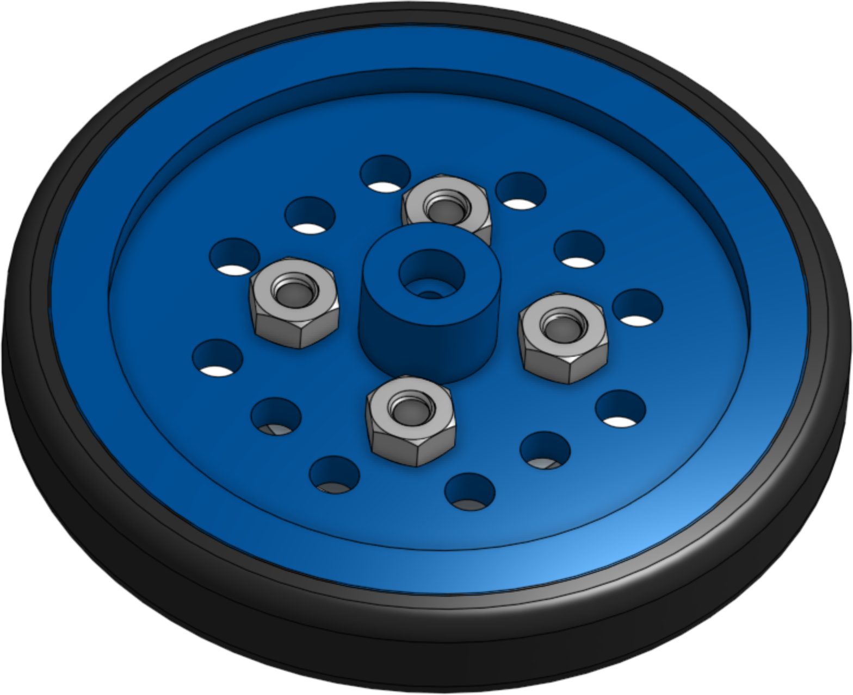
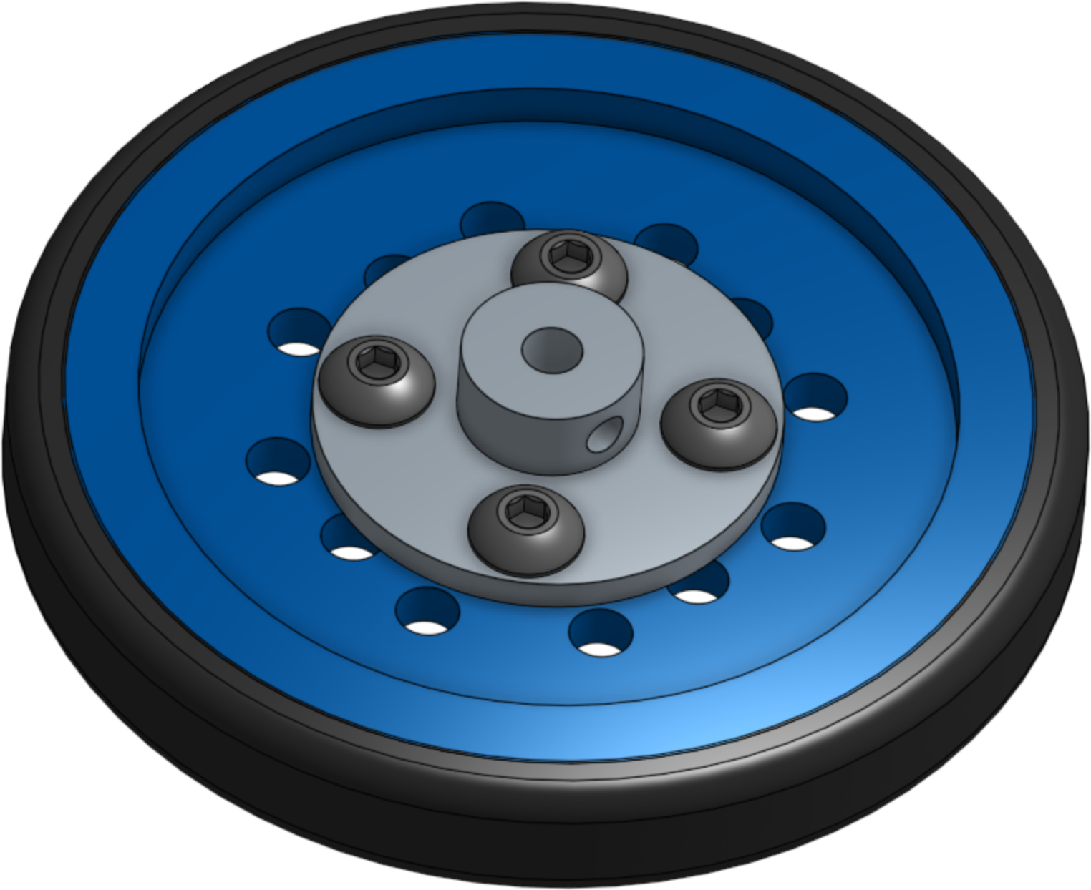
11
Attach the motor brackets
to the base plate.
x2
x4(16mm or 20mm)
x4
x4
M0
M1
12
Attach the wheels to the hubs.
x2
x2
x8(8mm)
x8

Slide 10
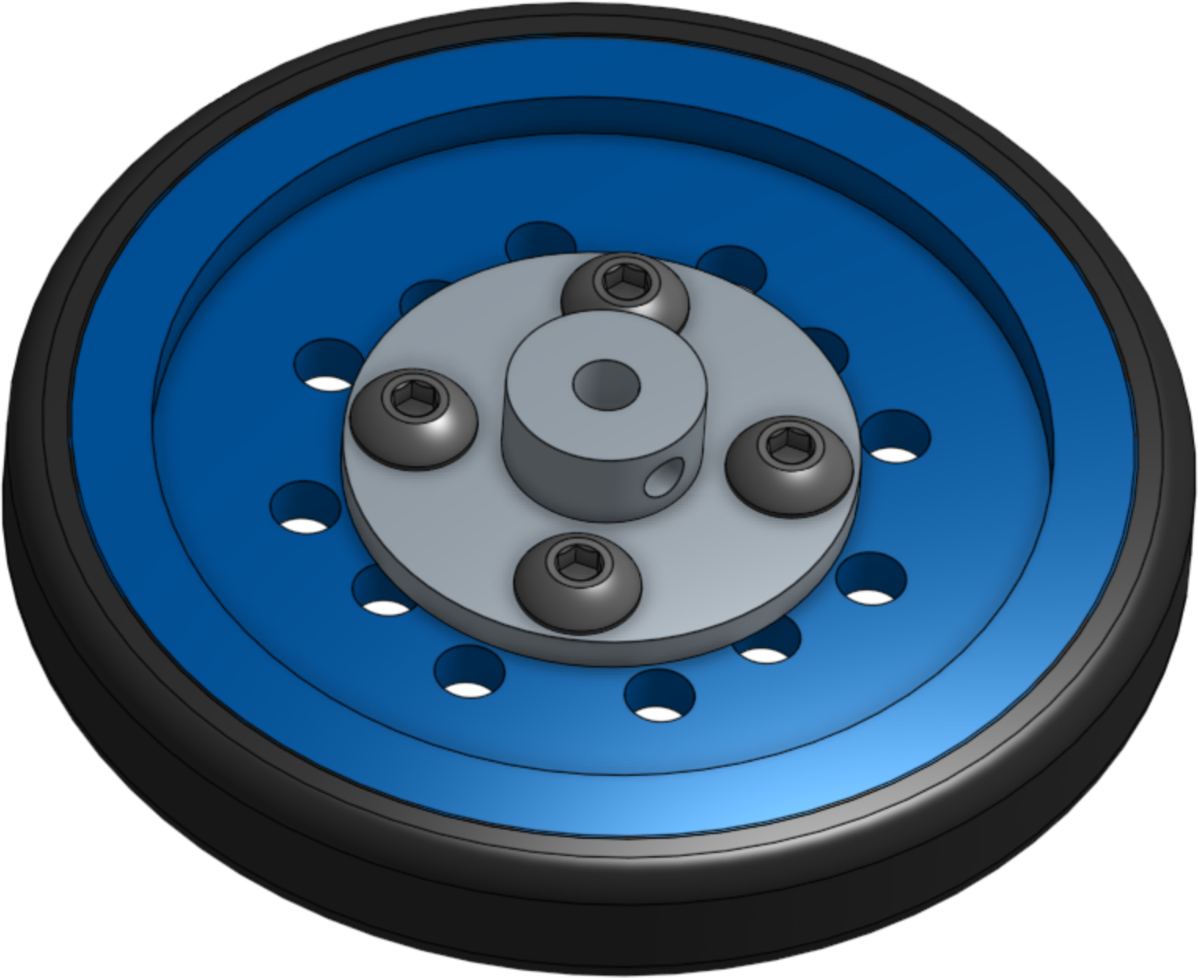
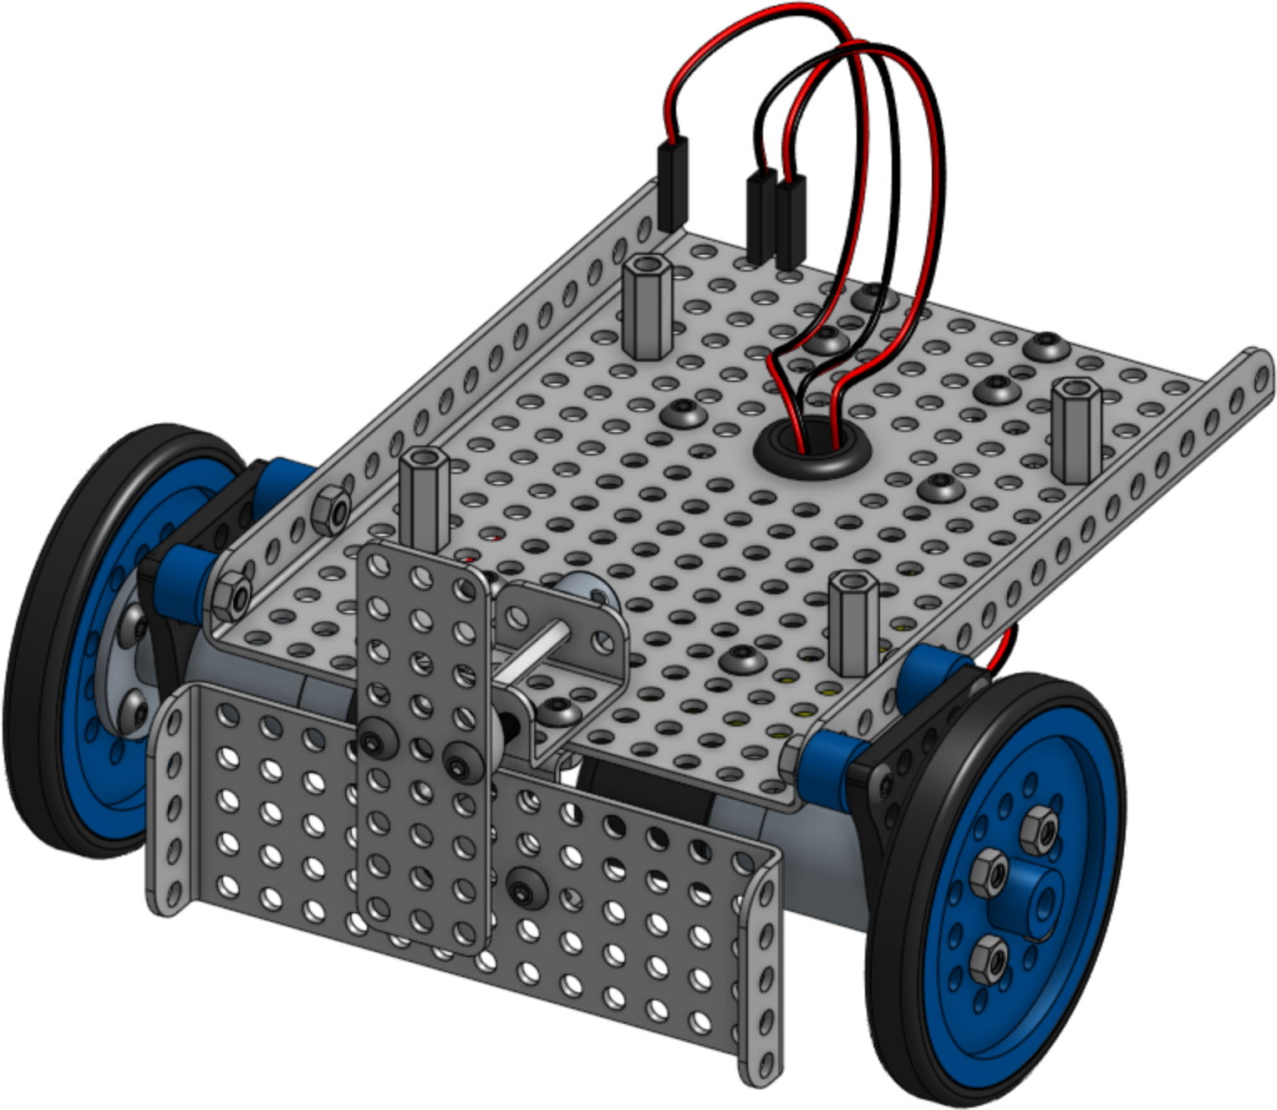
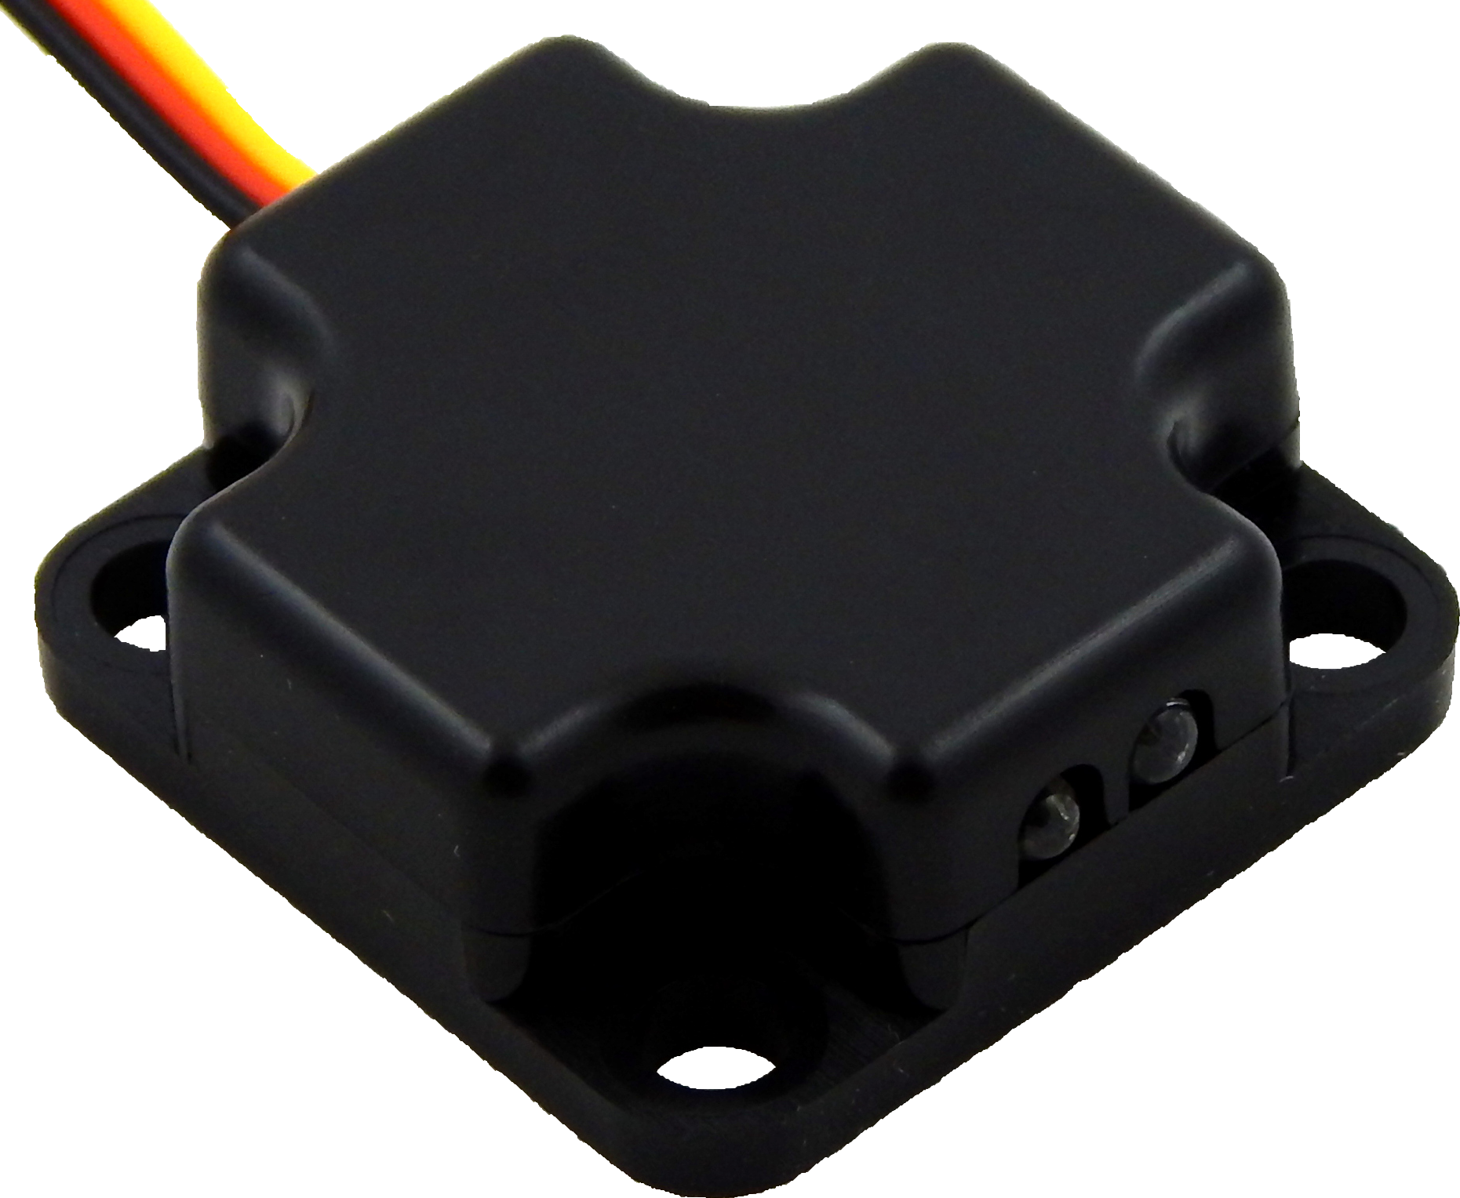
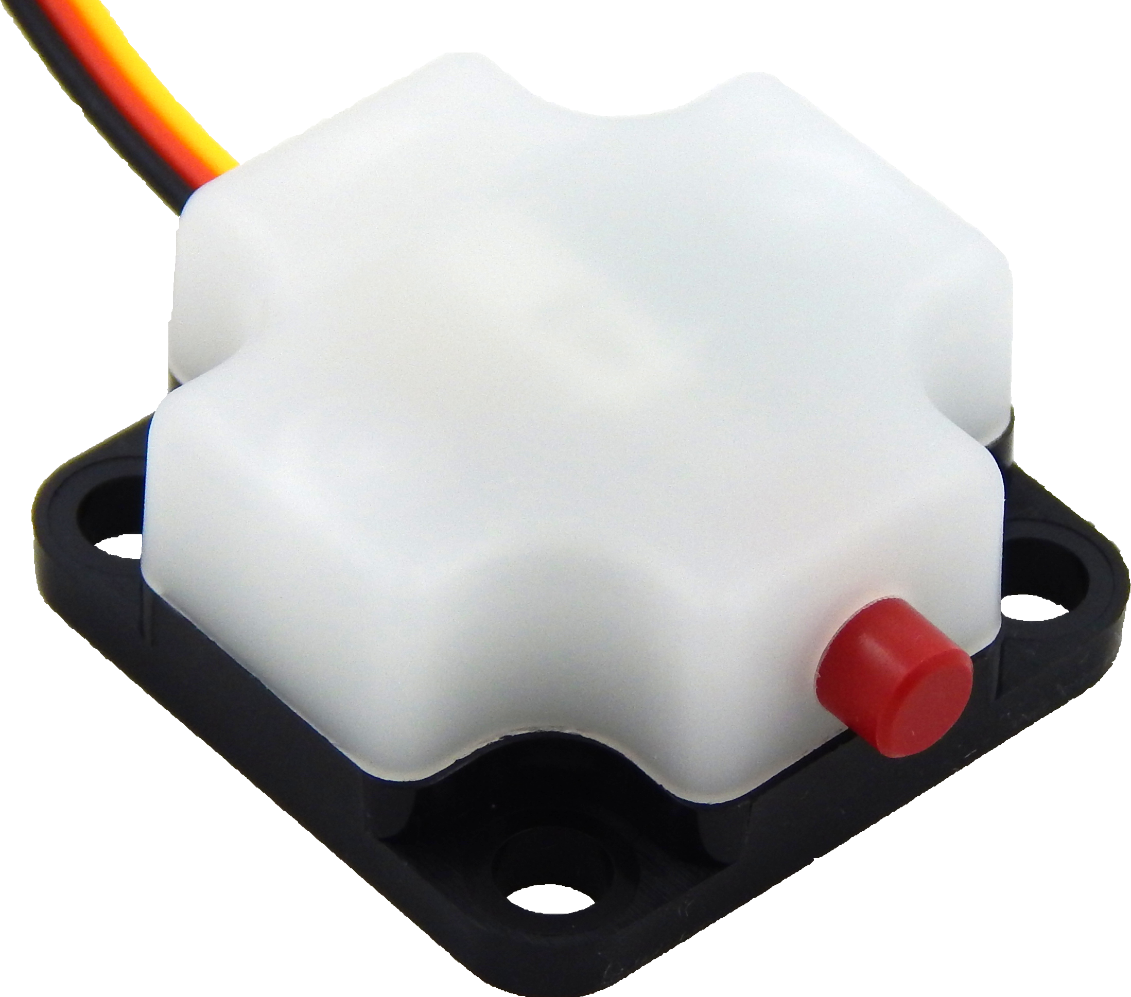
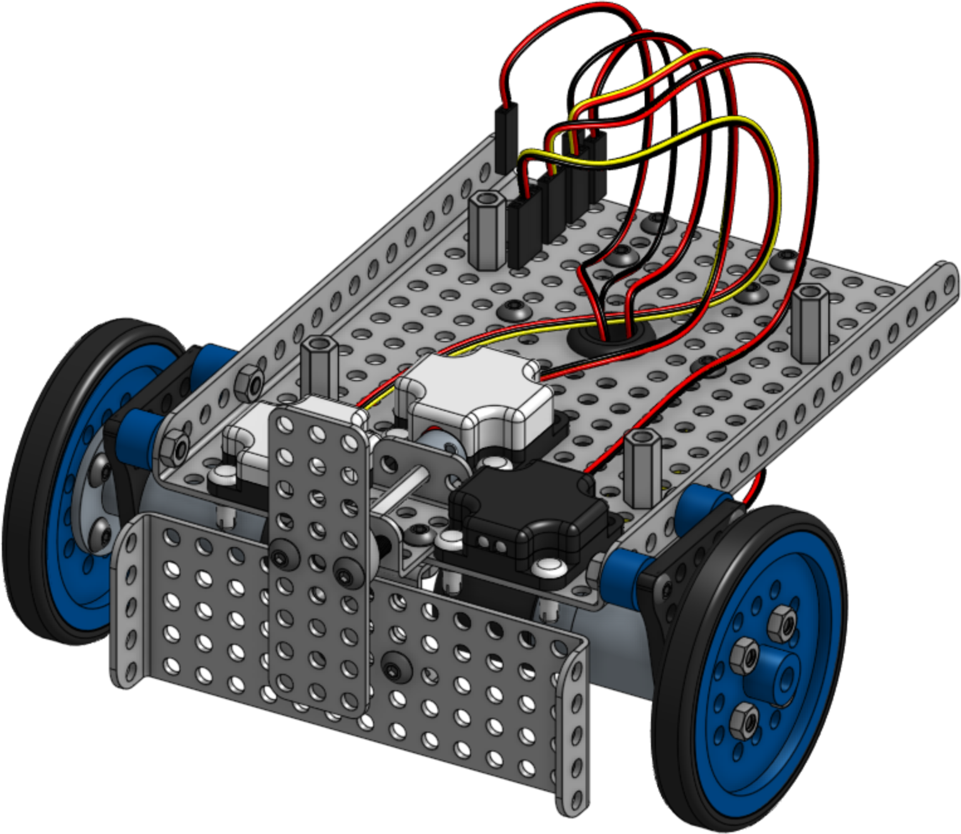
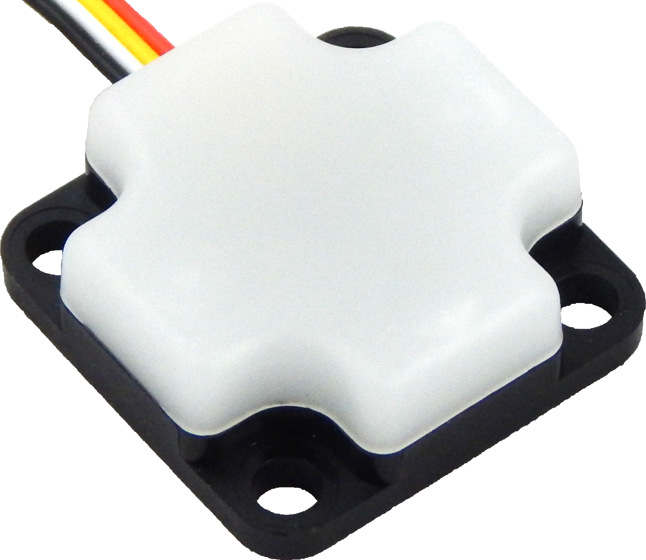
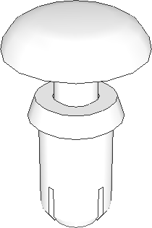
13
Attach the wheels to the motors
using the set screw in the hubs.
Tighten the set screw to the flat
part of the motor shaft.
x2
14
Reattach the sensors into the
position they were in before.
Note the quick connect location.
x1
x1
x1
x6

Slide 11
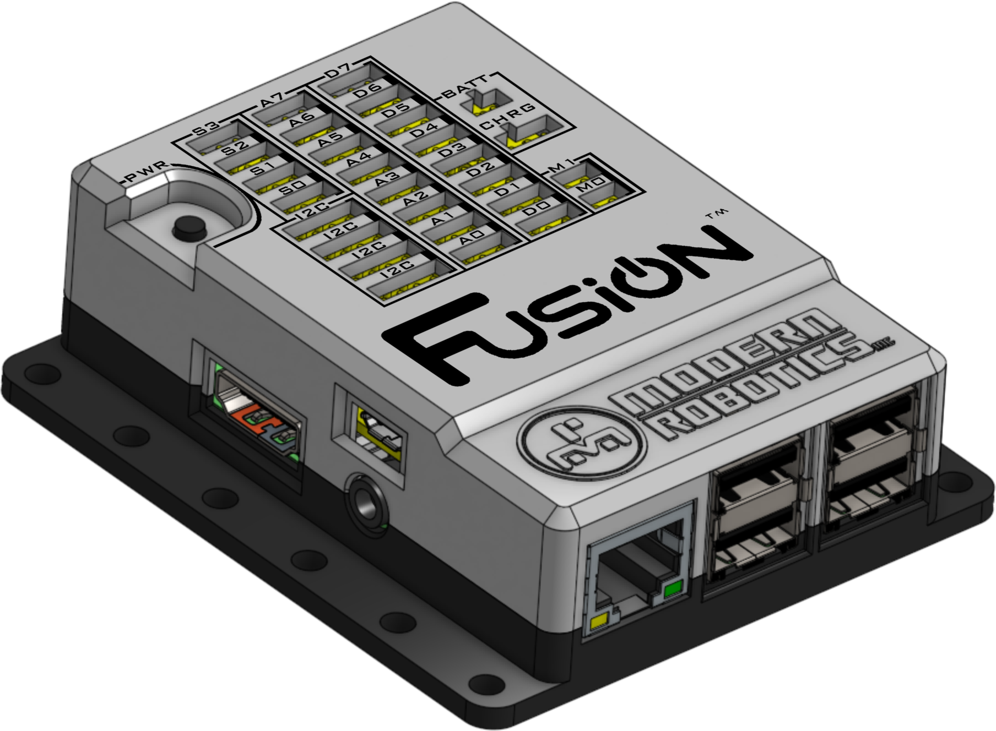

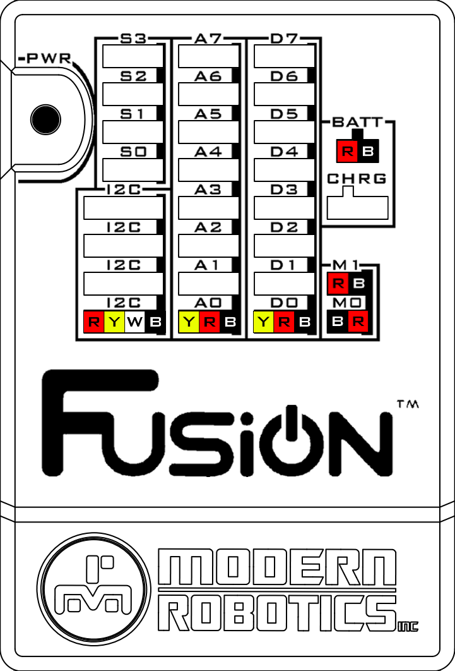
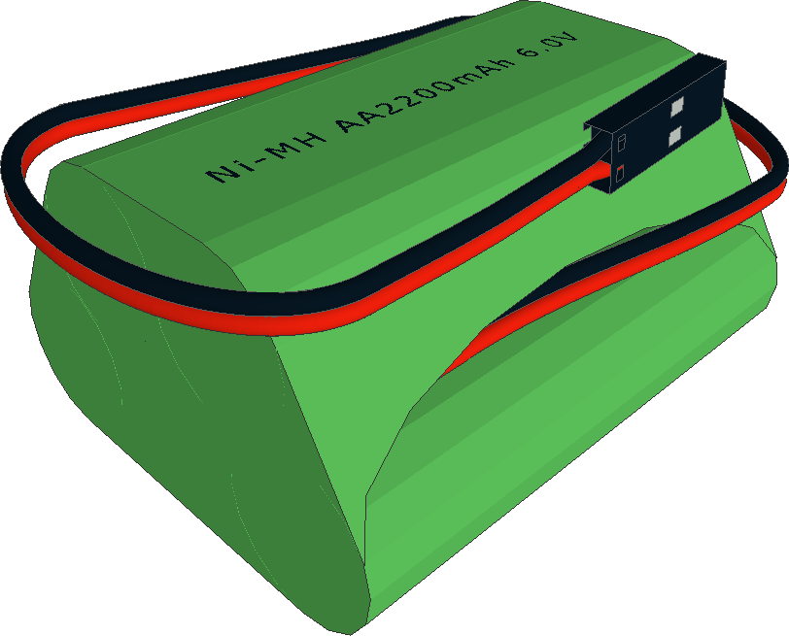
15
Reattach the Fusion Controller to
the standoffs.
x1
x4(8mm)
M0
M1
Optical Distance Sensor | → | A0
Touch Sensor | → | D0
Integrating Gyro | → | I2C
Right Motor | → | M0
Left Motor | → | M1
Battery | → | BATT

